Slide 1
Icarus Verilog

Slide 2
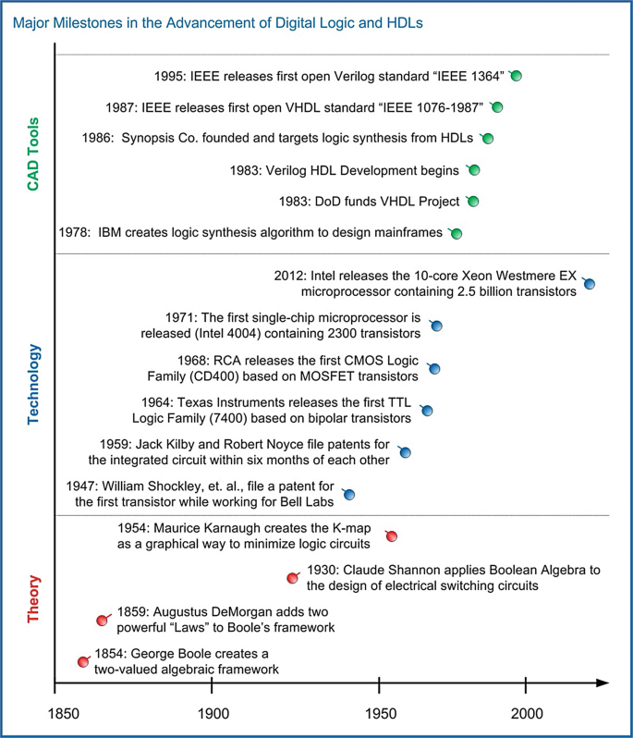

Slide 3
Hardware Description Languages (HDL)
There are two primary HDL languages used:
  VHDL – Very High Speed Integrated Circuit HDL
  Verilog

Slide 4
Verilog
Early 1984
Invented by Phill Moorby, Prabhu Goel
No Common HDL
Commonly used HDL’s were ABEL, LALSD, CUPSL and PALASM
To verify the logic no common simulators were available
Current Simulators such as ANSI, VCS, Model Sim.
Verilog – Verification + Logic -> VERILOG

Slide 5
Verilog
Versions are Verilog-95, Verilog-2001, Verilog-2005.
Other synthesizers are DC Compiler, RC Compiler, XST from Xilinx.
Standardized as IEEE 1364

Slide 6
Verilog & Icarus Verilog???
Textual format for describing electronic circuits and systems
Verilog simulation and synthesis tool
Operates as a compiler, compiling source code written in Verilog
Generates an intermediate form called vvp assembly
Executed by the vvp command

Slide 7
Windows
Download Icarus Verilog [https://bleyer.org/icarus/]
  iverilog-0.9.7_setup.exe (latest stable release)
Install Icarus Verilog with GTKwave
Install Notepad++ or VS Code
Set Environment Variables
  Control Panel->
  System and Security->
  System->
  Advanced system Settings->
  Advanced tab->
  Environment Variables

Slide 8
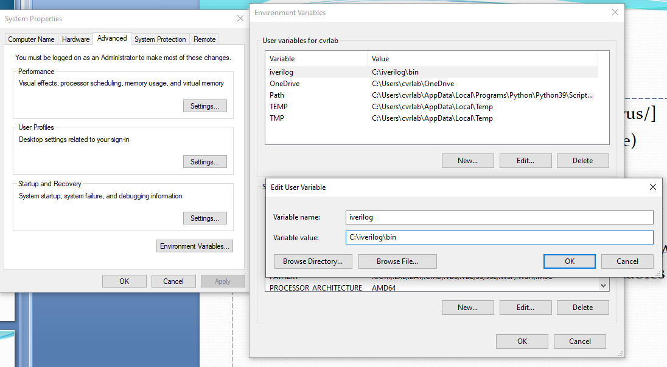

Slide 9
Ubuntu Linux
$sudo apt-get install iverilog
$ sudo apt-get install gtkwave
Install VS Code or any text editor

Slide 10
Verilog Abstraction Levels
Verilog supports a design at many levels of abstraction
  Behavioral level
  Register-transfer level
  Gate level

Slide 11
Behavioral Level
  Every algorithm is sequential
  Functions, tasks and blocks are the main elements.
  There is no regard for the structural realization of the design

Slide 12
Gate Level
  All signals are discrete signals, they can only have definite logical values (‘0’, ‘1’, ‘X’, ‘Z’)
  The usable operations are predefined logic primitives.

Slide 13
Register-Transfer Level / Dataflow level
  It specify a circuits characteristics using operations and the transfer of data between the registers.

Slide 14
Syntax
module [design_name] ([port_list]);
[list_of_input_ports]
[list_of_output_ports]
[declaration_of_other_signals]
[other_module_instantiations_if_required]
[code_for_this_module]
endmodule

Slide 15
Example
module hello;
initial
begin
$display("Hello, World");
$finish ;
end
endmodule
module test;
integer int_a;
real float_pt;
initial
begin
int_a = 8.2;
float_pt = 12.123;
$display("int_a =%d", int_a);
$display("float_pt =%f", float_pt);
$finish ;
end
endmodule

Slide 16
Format Specification
Argument Description
%h, %H Display in hexadecimal format
%d, %D Display in decimal format
%b, %B Display in binary format
%o or %O Display octal format
%m, %M Display hierarchical name
%s, %S Display as a string
%t, %T Display in time format
%f, %F Display 'real' in a decimal format
%e, %E Display 'real' in an exponential format

Slide 17
Getting Started
Use the ".v" or the ".vl" suffix to save the design
e.g:- hello.v
Compile the design to generate the object code:
iverilog -o hello hello.v
The "-o" flag tells the compiler where to place the compiled result .
Execute the compiled program.
vvp hello -> run time engine

Slide 18
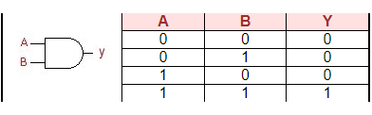
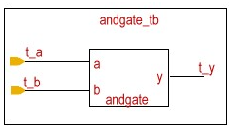
AND gate

Slide 19
Gate Level
module AND_2_gate (output c, input a, b);
and (c, a, b); // c is the output, a and b are inputs
endmodule
Data Flow Level
module AND_2_dataflow (output Y, input A, B);
assign Y = A & B;
endmodule

Slide 20
Behavioural
module AND_2_behavioral (output reg Y, input A, B);
always @ (A or B) begin
if (A == 1'b1 & B == 1'b1) begin
Y = 1'b1;
end
else
Y = 1'b0;
end
endmodule

Slide 21
Generating VCD/LXT files GTKwave
GTKWave is a VCD waveform viewer based on the GTK library.
This viewer support VCD and LXT formats for signal dumps.
Look at the test.vcd waveform
  gtkwave filename.vcd &
  Click on the 'test', then 'c1' in the top left box on GTKWAVE

Slide 22
THANK YOU!!!

